Slide 1
CND212: Digital Testing and Verification

Slide 2
SV OOP Program Constructs
Building SystemVerilog OOP structure vs. building a Verilog RTL structure
 | RTL | OOP
Block definition | Module | Class
Block instance | Instance | Object
Block name | Instance name | Handle
Data types | Reg, wire, logic, bit... | Properties (variables)
Functionality | Tasks and functions Behavioral blocks: always/initial | Methods (subroutines): Tasks/functions
Communication between blocks | Ports or interfaces between modules | Task/ function calls, mailboxes, semaphores…

Slide 3
SV OOP Key Concepts
Encapsulation: Creating containers of data along with the associated behaviors.
Inheritance: Hiding the implementation details to reduce the complexity and raise the abstraction level.
Polymorphism is the reuse of the same code to take on many different behaviors based on the type of object at hand.

Slide 4
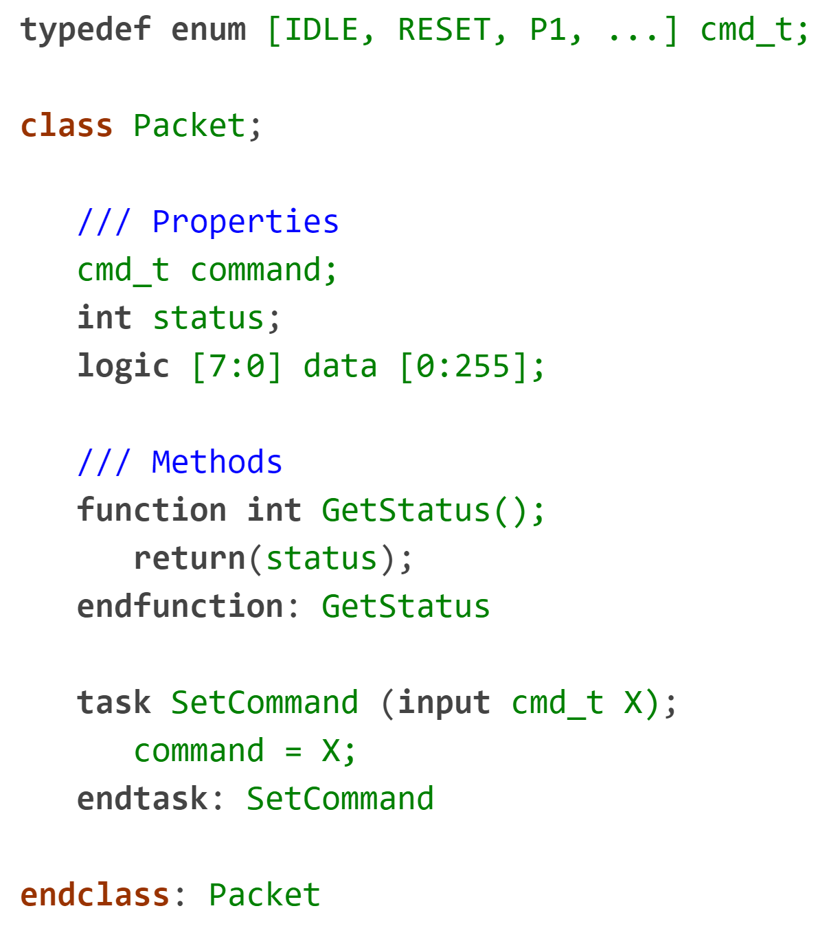
class - (OOP Encapsulation)
A Class is a type and an OOP construct that encapsulates:
Variables (properties) used to model a system
Subroutines (methods) to manipulate the data
Properties and methods are called members of a class
The class properties and methods, taken together, define the contents and capabilities of some object

Slide 5
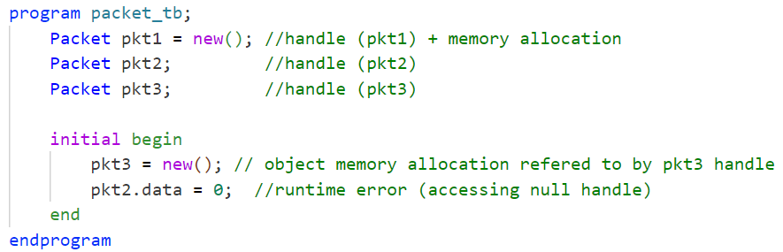
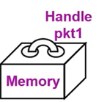

class instance (object)
OOP objects are built from class definitions
An object is an instance of that class (similar to module instances)
An object can be used when you:
Declare a variable of that class type (that holds an object handle)
Create an object of that class and allocate memory for it (using the new() method)
Uninitialized object handles are set by default to the special value null.
Object members are accessed using the object handle
Accessed via the (.) notation

Slide 6
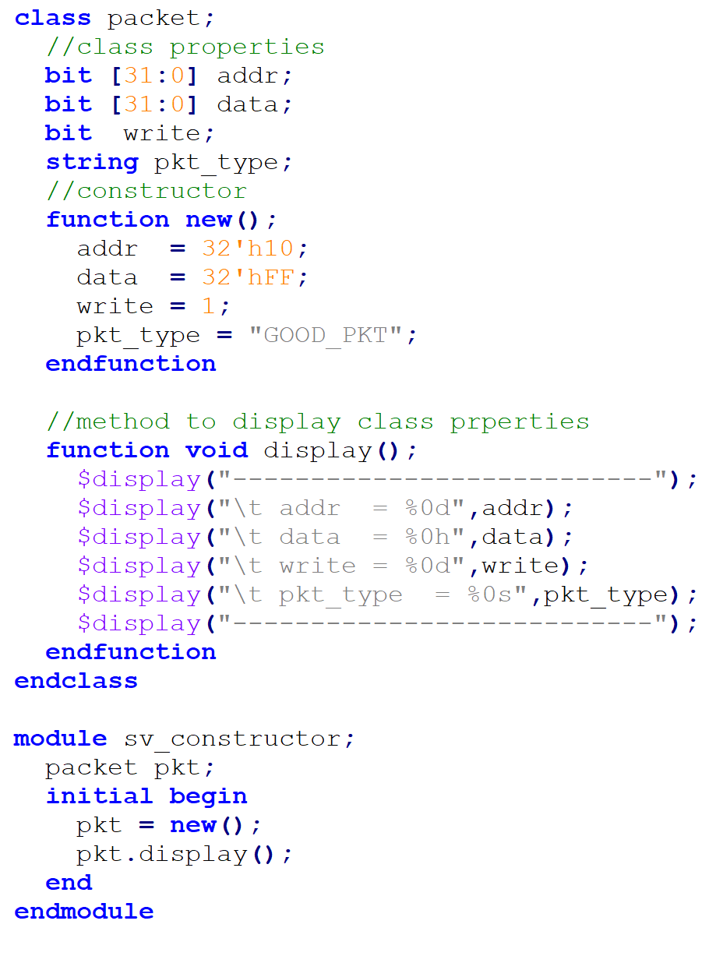
Initialization of Object Members (class constructor)
Define constructor new() in class to initialize properties
Function with no return type
Executes immediately after object memory is allocated
Not accessible via the dot (.) notation
function new() gives default values to the arguments so that any object created will have these default values unless overridden.
new() is now being used in two very different contexts
Object instance
Object members’ initialization
Calling the class's constructor without explicitly defining its new method will call its default built-in new method

Slide 7
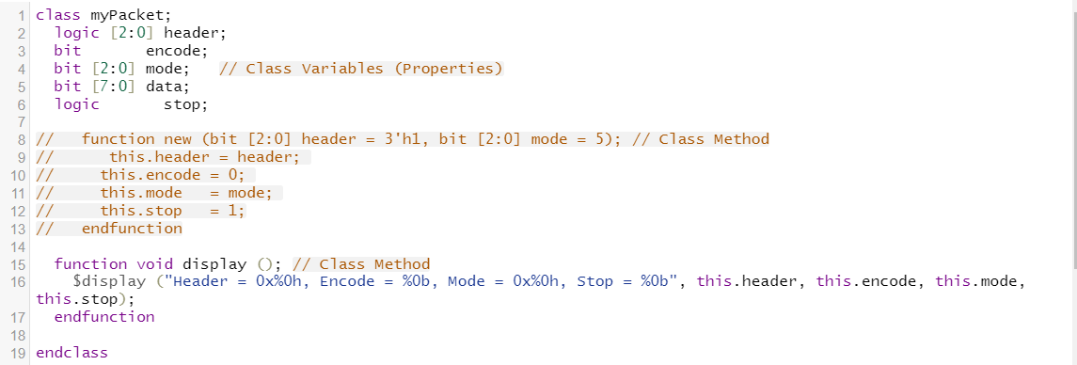
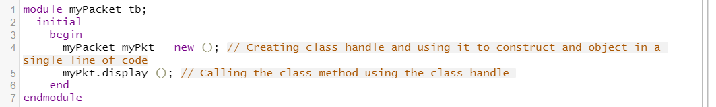
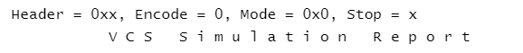
Initialization of Object Members - class constructor
If a class does not provide an explicit user-defined new method, an implicit new method shall be provided automatically
“this” keyword is used to refer to the current class and used inside the class to refer to its own variables and methods.

Slide 8
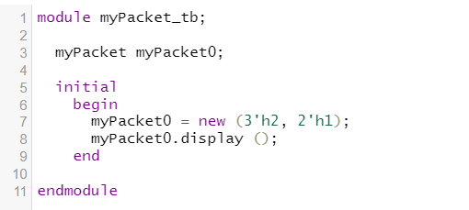

Initialization of Object Members - Custom Constructor
Upon the creation of the object, we can pass values to the constructor

Slide 9
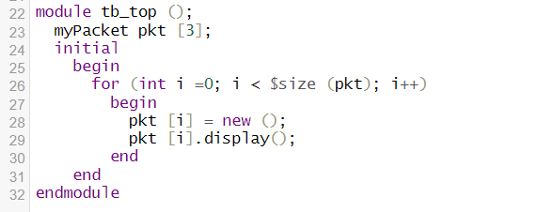
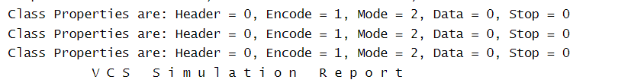
Creating an array of classes
An array of classes can be created in a way similar to how you create, for example, an int array type

Slide 10
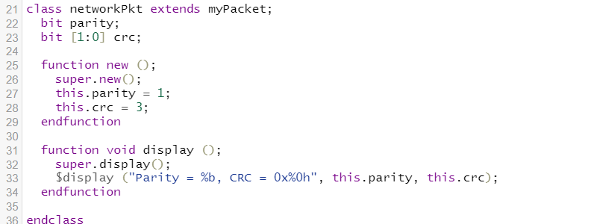
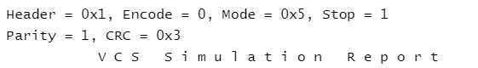
Inheritance and subclasses
In a previous example a class called myPacket was created. This class can be extended to add more properties and/or methods
In other words, a subclass is created that inherits the base class without re-implementing its properties and methods.
To call the methods of the base class inside the inherited one, use the keyword “super”
Notes:
there’s a class called networkPkt that extends “inherits” the base class myPacket. The class networkPkt has a constructor that calls the constructor of the base class.
To call the methods of the base class inside the inherited one, use the keyword “super”.

Slide 11
Polymorphism - Abstract/Virtual Class
Polymorphism means having many forms.
It is the ability to have the same code act differently for different types of objects.
An abstract/virtual class is a class you cannot create an object from.
It’s useful if you want to force other users to not create an object of your class and rather extend it.
The keyword “virtual” is used to create an abstract class.

Slide 12
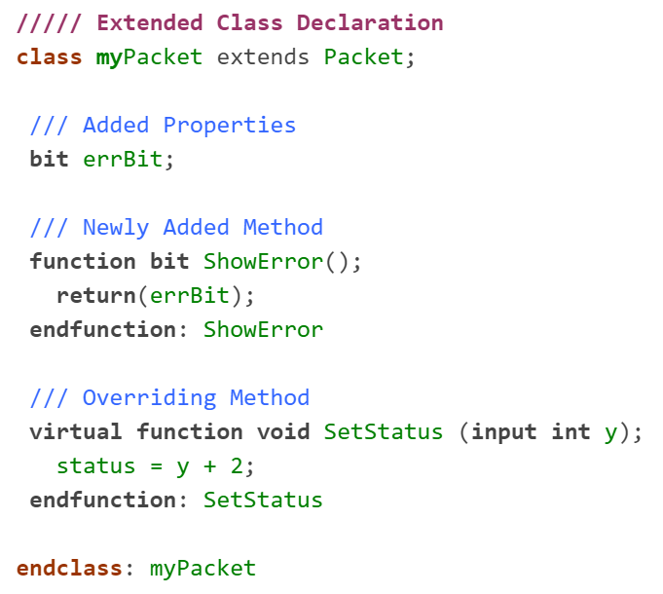
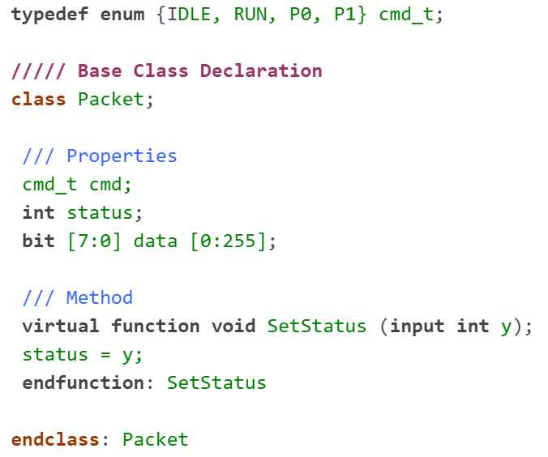
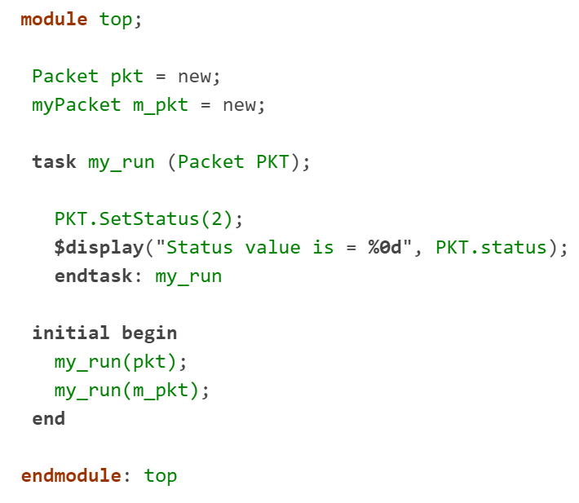

Polymorphism – Virtual Methods
Virtual class methods allow accessing different code implementations during runtime.
Overriding virtual methods must have the same prototype.
Declaring a method as virtual always means it is virtual in all extended classes

Slide 13
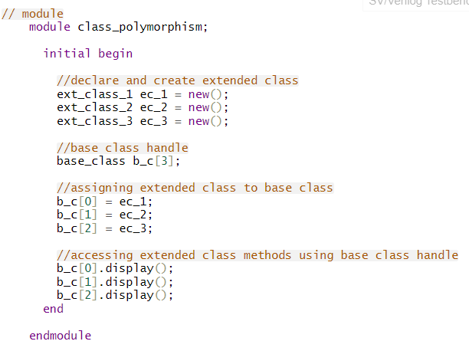
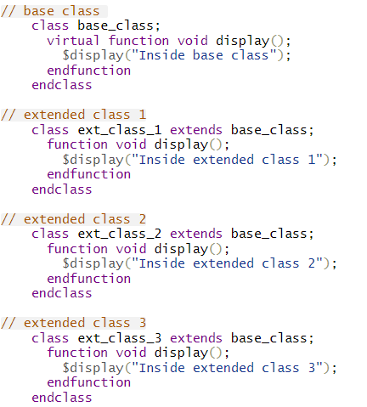

Polymorphism

Slide 14
Shallow & Deep Copy
SystemVerilog deep copy copies all the class members and its nested class members.
Unlike in shallow copy, only nested class handles will be copied.
In shallow copy, Objects will not be copied, only their handles will be copied.
To perform a full or deep copy, a custom method needs to be added. In the custom method, a new object is created, all the class properties will be copied to a new handle, and the new handle will be returned.

Slide 15
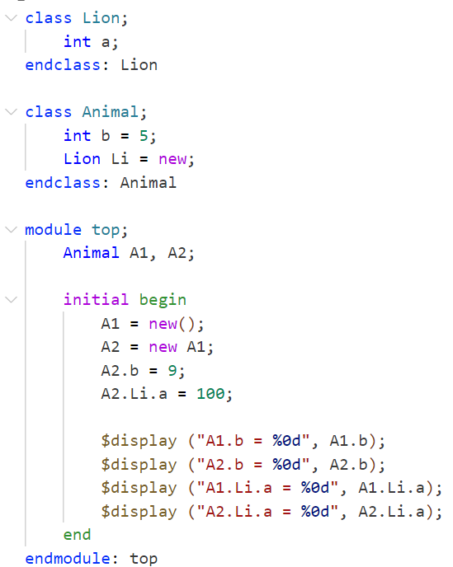
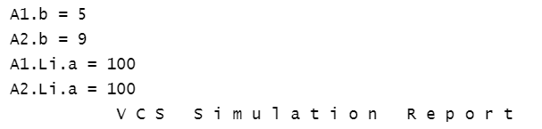
Shallow Copy - Example
Shallow copy allocates the memory, copies the variables, and returns the memory handle.
Changes made by A2 will not be reflected on A1.
Shallow copy allows only the first level of Properties to be copied, not the Object inside the Parent class.

Slide 16
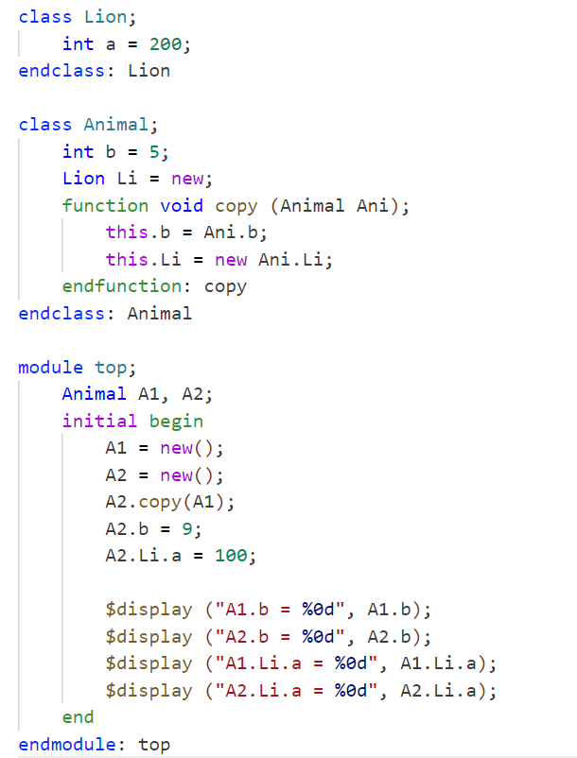
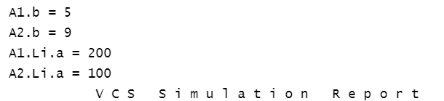
Deep Copy - Example
Deep Copy is done by creating a copy() function.

Slide 17
module vs. class
Why use class?
Objects are dynamic, modules are static
Objects are created and destroyed as needed
Instances of modules can not be passed, copied, or compared
Instances of classes are objects (class instance)
Object Handles can be passed as arguments
Object memory can be copied or compared
Classes can be inherited, modules can not
Classes can be modified via inheritance without impacting existing users
Modifications to modules will impact all existing users

Slide 18
Lab Task (~ 60 min)

Slide 19
Lab Task
Build a transceiver system that has two instances:
Transmitter
Receiver
The transceiver class sends data from the transmitter to the receiver.
The Transmitter and Receiver are extended from a base class comm_component.
The comm_component class has the following properties:
Data
Address
The comm_component class has the following methods:
Initialize
Display

